Slide 1
Short-Term Rental Platform vs. Long-Term Tenant: Evaluating Expected Profits

Slide 2
Introduction
1

Slide 3
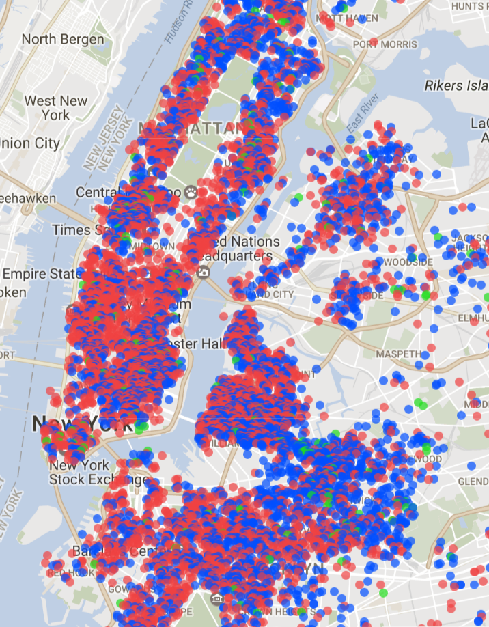

Slide 4
NYC STR Market
The largest supply in the country
Legal fight between NYC and AirBnB
Professional/Property Management companies

Slide 5
Key Stakeholders
Hosts that want to maximize their profit
Professional/Property Management companies
Short-Term Rental Platforms

Slide 6
Objectives
Specific Neighborhoods to maximize Profit
Dynamic Pricing is the Way
Difficult to Implement without right data
Another one

Slide 7
Data & Methodology
2

Slide 8
Methodology
Scrape Zillow Listings
Calculate Prices and Occupancies using AirBnB Data
Find units that maximize expected profits

Slide 9
Zillow
Scraped Zillow Listings for each Neighborhood
For all links that were buildings, found individual listings
Scraped all individual listings for prices, sqft, bedrooms etc.

Slide 10
AirBnB
Found data on insideairbnb.com
Calculated monthly prices and occupancies
Aggregated with Listings Data

Slide 11
Zillow
3
Let’s start with the first set of slides

Slide 12
Scraping Process
Found URLs for each neighborhood
Scraped URLs
Two types of listings:
Buildings
Unique apartment listings
Re-scraped the building listings to find unique apartment listings.
Scraped all unique listings to find:
Price
Sqft
Bedrooms

Slide 13
Zillow Data
Narrowed the data to remove outliers
Studio - 4 bedrooms
Price - luxury apartments would be outliers
Sqft - removed listings with more than 3000 sqft
Linear Regression to predict missing sqft
MSE: 41809
R²:
Aggregated data to be used with AirBnB data

Slide 14
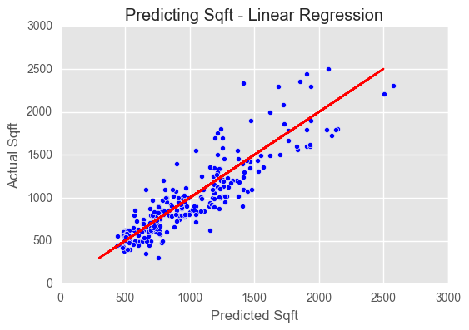

Slide 15
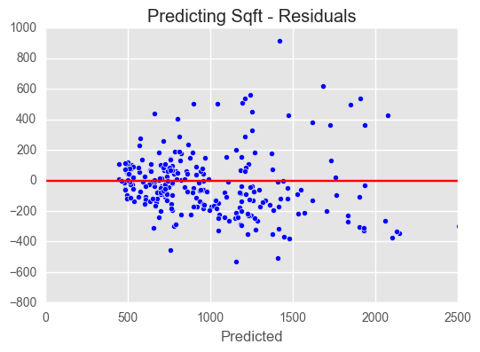

Slide 16
AirBnB
4
Let’s start with the first set of slides

Slide 17
Terminology
Occupancy: Days occupied in a time frame
ADR: Average Daily Rate
RevPAR: Revenue per Available Room (time frame)
Rating: Average Rating of a Listing on AirBnB
Proxy for Credibility
Number of Reviews:
Proxy for Listing Activity
Neighborhood
Certain Neighborhoods can charge more
Month: Seasonality

Slide 18
AirBnB Data
Used data from insideairbnb.com
Not scraped regularly
Lead to lower occupancies and price
Used 2015 and 2016 data
2016 was not complete, missing last two months
Calendar scrapes were per day
Calculated median price and occupancy %
Data aggregated by listing, month
Combined with listing data to get bedrooms, neighborhood
Two Models
Model I - Evaluate expected profits for private room
Model II - Evaluate expected profits for entire unit

Slide 19
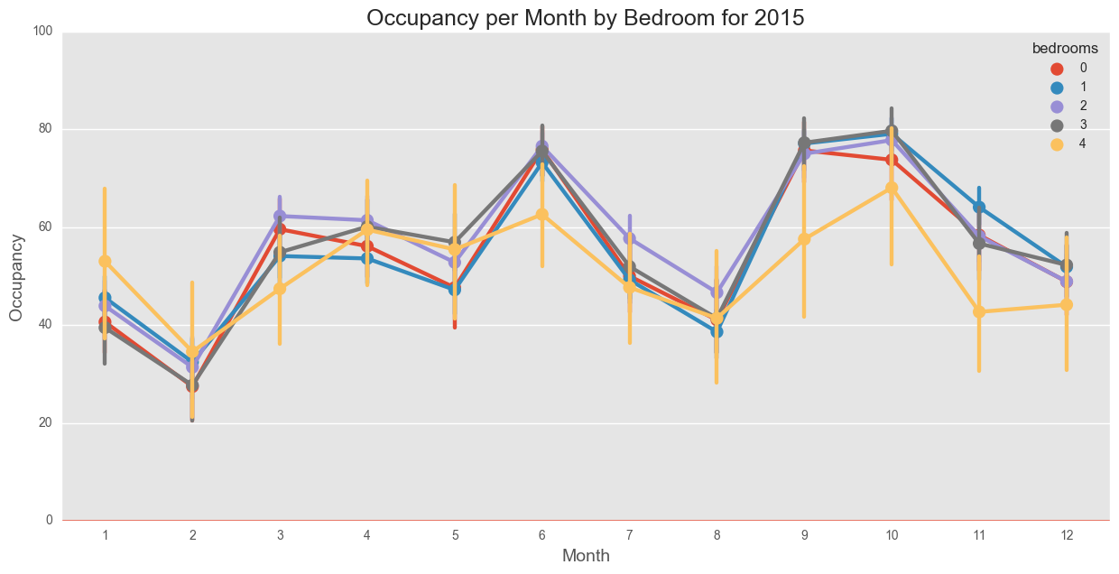

Slide 20
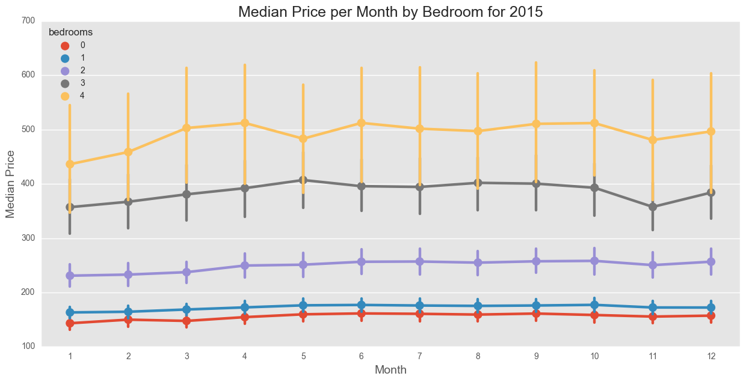

Slide 21
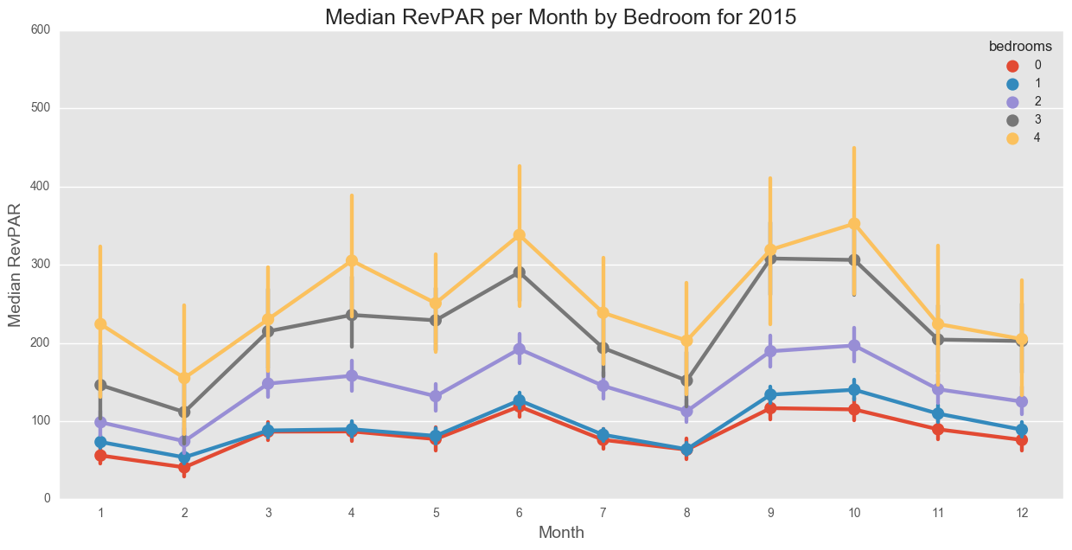

Slide 22
AirBnB Model I
Features for Model I:
Month
Occ %
Neighborhood
Number of Reviews
Rating
Extra Trees performed the best
MSE: 155
R²: 0.74
Distribution of prices were between 50 and 120
Pricing model does not work for a Private Room
Missing features

Slide 23
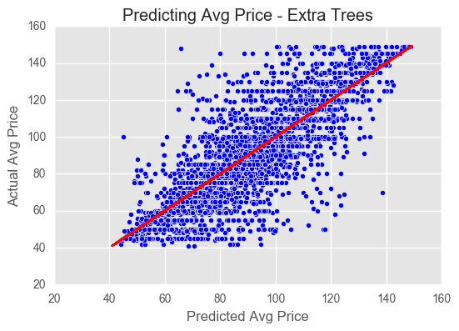

Slide 24
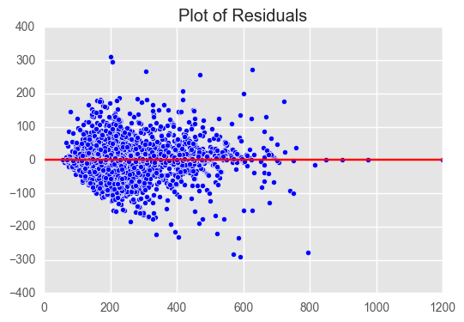

Slide 25
Model I Results
Feature Importances
Number of Reviews: 0.34
Neighborhood: 0.22
Rating: 0.19
Not enough variation to explain pricing
Missing Features (i.e photo and listing quality)
Apply average neighborhood price (yearly) to zillow listings
Zillow listings that maximize expected profit
Midtown dominated the listings
High tourist traffic
Locals do not want to live near Times Square (cheaper $/sqft)

Slide 26
AirBnB Model II
Features for Model I:
Month
Occ %
Bedrooms
Neighborhood
Number of Reviews
Rating
Extra Trees performed the best
MSE: 1072
R²: 0.89
Enough variation to implement Dynamic Pricing model

Slide 27
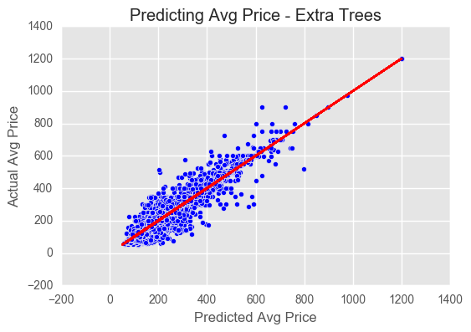

Slide 29
Model II Results
Not enough variation to explain pricing
Need photo and listing quality
Apply average neighborhood price (yearly) to zillow listings
Zillow listings that maximize expected profit
Midtown dominated the listings
High tourist traffic
Locals do not want to live near Times Square
Clinton Hill (Brooklyn) projected close second

Slide 30
Conclusions
6
Let’s start with the first set of slides

Slide 31
Best Neighborhoods
Using Extra Trees, best places to find units for STR
Model I - Private Rooms - Midtown
Model II - Midtown (Manhattan), Clinton Hill (Brooklyn)
Future Considerations
Use future AirBnB scraping Data
Better Estimation of Prices and Occupancies
Scrape new Zillow Listings
Count Vectorization to understand Listing Quality
Are more number of bedrooms better?
Limit to Zillow Listings without Doorman/Non-Luxury

Slide 34
You can also split your content
White
Is the color of milk and fresh snow, the color produced by the combination of all the colors of the visible spectrum.
Black
Is the color of coal, ebony, and of outer space. It is the darkest color, the result of the absence of or complete absorption of light.

Slide 35
In two or three columns
Yellow
Is the color of gold, butter and ripe lemons. In the spectrum of visible light, yellow is found between green and orange.
Blue
Is the colour of the clear sky and the deep sea. It is located between violet and green on the optical spectrum.
Red
Is the color of blood, and because of this it has historically been associated with sacrifice, danger and courage.

Slide 36

A picture is worth a thousand words
A complex idea can be conveyed with just a single still image, namely making it possible to absorb large amounts of data quickly.

Slide 37

Want big impact?
Use big image.

Slide 38
Use charts to explain your ideas
White
Gray
Black

Slide 39
And tables to compare data
 | A | B | C
Yellow | 10 | 20 | 7
Blue | 30 | 15 | 10
Orange | 5 | 24 | 16

Slide 40
89,526,124
Whoa! That’s a big number, aren’t you proud?

Slide 41
89,526,124$
185,244 users
100%
That’s a lot of money
And a lot of users
Total success!

Slide 42
Our process is easy
first
second
last

Slide 43
Our sales funnel
20%
40%
60%
80%
Diagram featured by http://slidemodel.com
100%

Slide 44
Let’s review some concepts
Yellow
Is the color of gold, butter and ripe lemons. In the spectrum of visible light, yellow is found between green and orange.
Blue
Is the colour of the clear sky and the deep sea. It is located between violet and green on the optical spectrum.
Red
Is the color of blood, and because of this it has historically been associated with sacrifice, danger and courage.
Yellow
Is the color of gold, butter and ripe lemons. In the spectrum of visible light, yellow is found between green and orange.
Blue
Is the colour of the clear sky and the deep sea. It is located between violet and green on the optical spectrum.
Red
Is the color of blood, and because of this it has historically been associated with sacrifice, danger and courage.

Slide 45
Place your screenshot here
Desktop project
Show and explain your web, app or software projects using these gadget templates.

Slide 46
Thanks!
Any questions?
You can find me at:
@username
user@mail.me

Slide 47
SlidesCarnival icons are editable shapes.
This means that you can:
Resize them without losing quality.
Change fill color and opacity.
Change line color, width and style.
Isn’t that nice? :)
Examples:

Slide 48
😉
Now you can use any emoji as an icon!
And of course it resizes without losing quality and you can change the color.
How? Follow Google instructions https://twitter.com/googledocs/status/730087240156643328
✋👆👉👍👤👦👧👨👩👪💃🏃💑❤😂😉😋😒😭👶😸🐟🍒🍔💣📌📖🔨🎃🎈🎨🏈🏰🌏🔌🔑 and many more...

